Slide 1
CarbEF: A software for reporting carbon emissions from deforestation and degradation
Verhegghen A., Combal B., Eva H. (JRC)
with the contribution of Bodart C. (JRC) and Arquero A. (FAO)

Slide 2
CarbEF – An indirect approach to quantify degradation
A single tool to calculate areas and CO₂ emissions
Compliant with the IPPC guidelines of forest definition
Users have the control on the choice of the input data (tree cover loss map, biomass, forest definition)
Mandatory inputs: map of tree cover loss and estimates of carbon stock
Computation uses a grid to allow comparison in time
Production of reports (html, excel) with the estimations
Open source

Slide 3
Forest definition
FAO, UNFCCC: based on three criteria
Minimum forest area,
Minimum tree height,
Tree cover density
Each country has its own parameters
 | Superficie (ha) | Hauteur arbres (m) | Densité du couvert (%)
Republique of Congo | 0.5 | 3 | 30
Cameroon | 0.5 | 5 | 10
Tanzania | 0.5 | 3 | 10

Slide 4
Forest degradation
Forest degradation occurs when changes happens in terms of tree cover or tree height, but the area is still considered as a forest
T1 T2 T3
3 m
 | T1 | T2 | T3
Minimum Area (ha) | 0.5 | 0.5 | 0.5
Tree Height (m) | 10 | 7 | 5
Tree cover (%) | 100 | 70 | 40
CO ₂ emissions ?

Slide 5
CarbEF input: A Tree cover loss map
Map of tree cover loss indicating pixels passing from a tree cover (TC) class at time T0
to a non tree cover (NTC) class at time T1
T0
TC
Forest no change
TC - TC
NTC
Non-forest no change
NTC - NTC

Slide 6
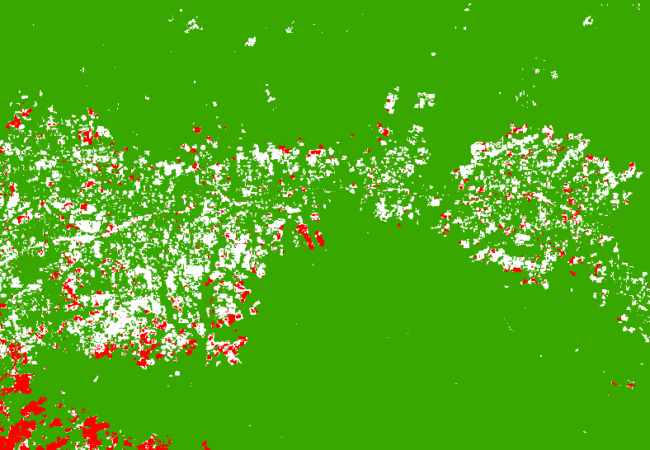
CarbEF input: A Tree cover loss map
Map of tree cover loss indicating pixels passing from a tree cover (TC) class at time T0
to a non tree cover (NTC) class at time T1
T0-T1
T0
TC
Forest no change
TC - TC
NTC
Non-forest no change
NTC - NTC
TC - NTC
Loss of forest

Slide 7
Grid of Minimum Forest Unit
CarbEF analyzes the tree cover loss map inside a grid of Minimum Forest Unit (MFU)
The MFU size ~ minimum area of the forest definition
MFU classified according to the tree cover threshold

Slide 8
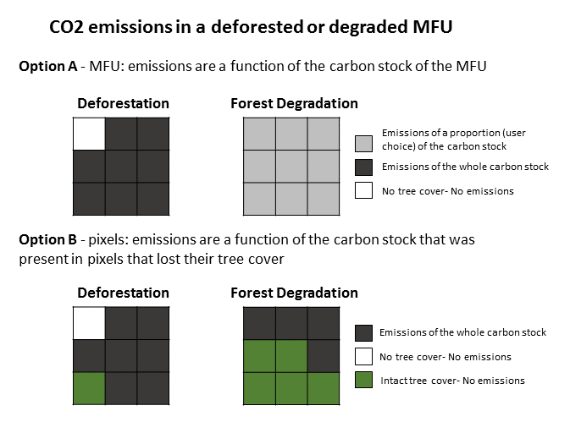
Area and emissions estimations
Emission factor applied to any MFU classified as
Deforestation
Forest Degradation
Different options to report the areas of forest changes and the associated CO ₂ emissions

Slide 9
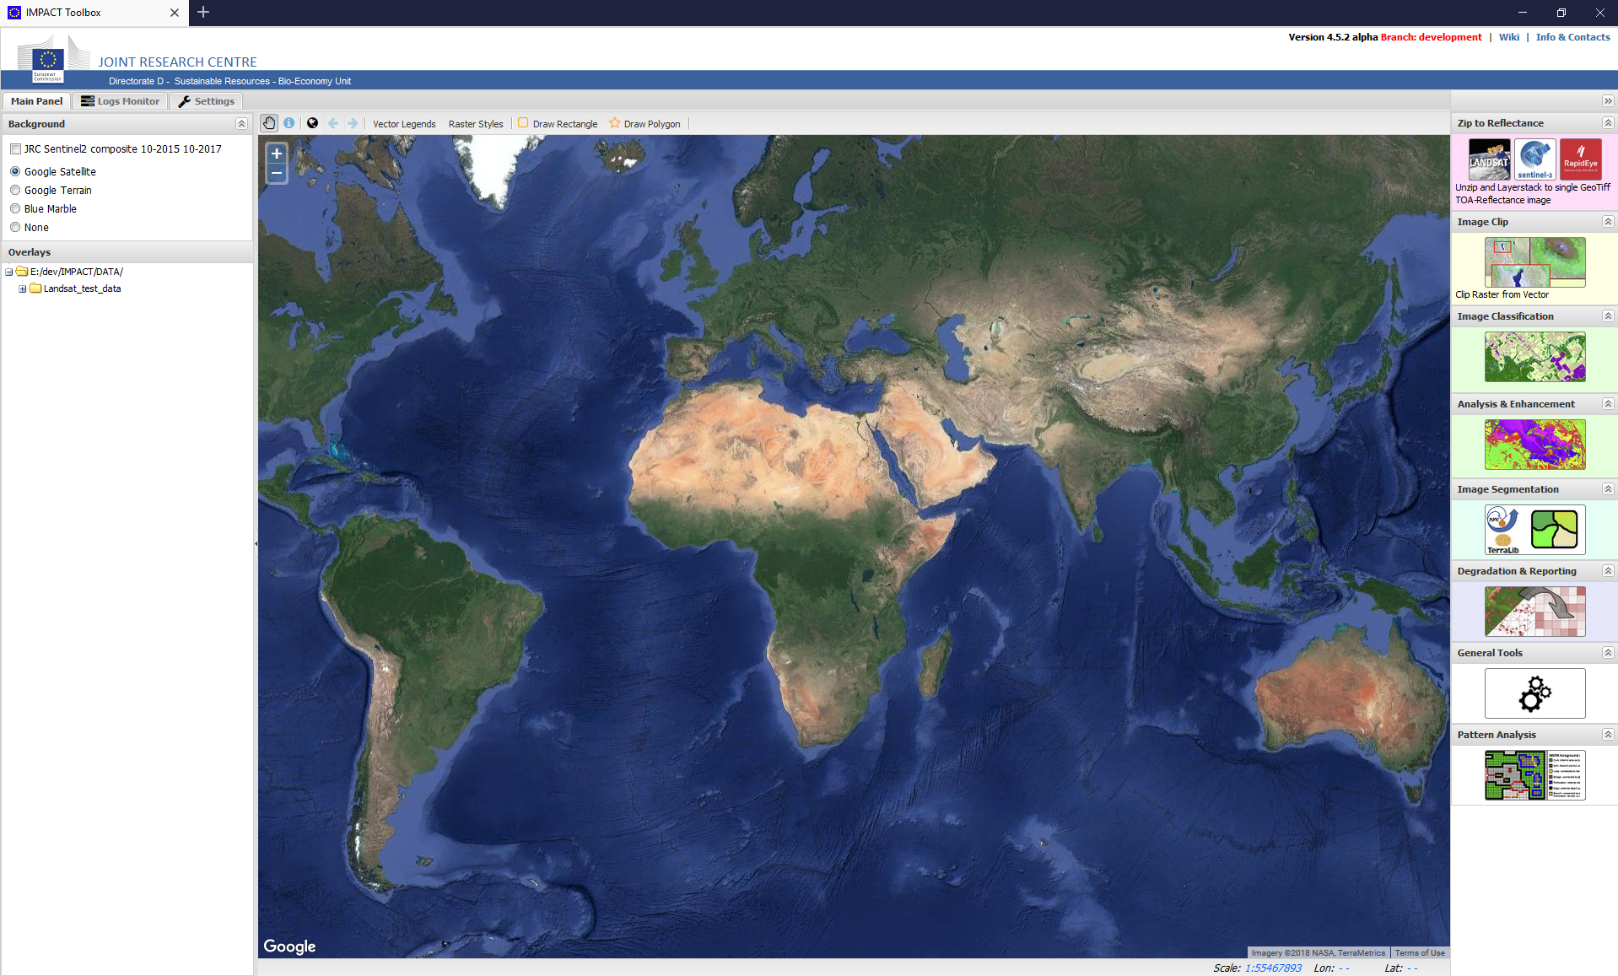
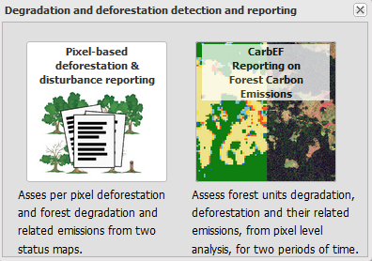
CarbEF in IMPACTools

Slide 10
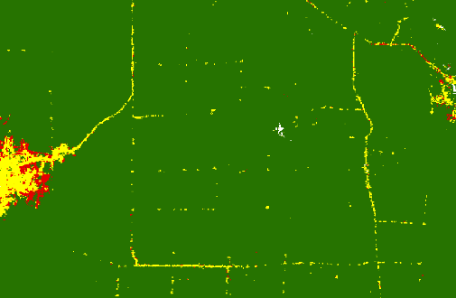
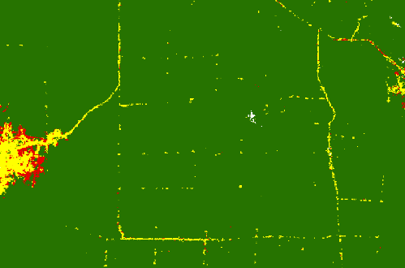
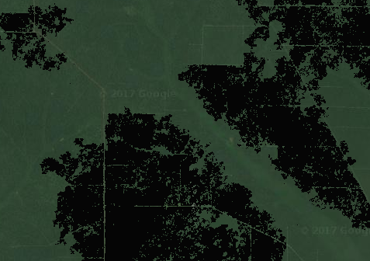
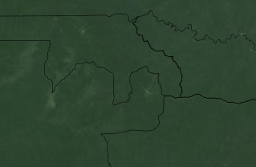
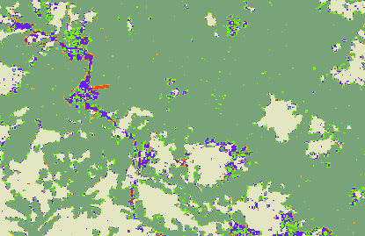
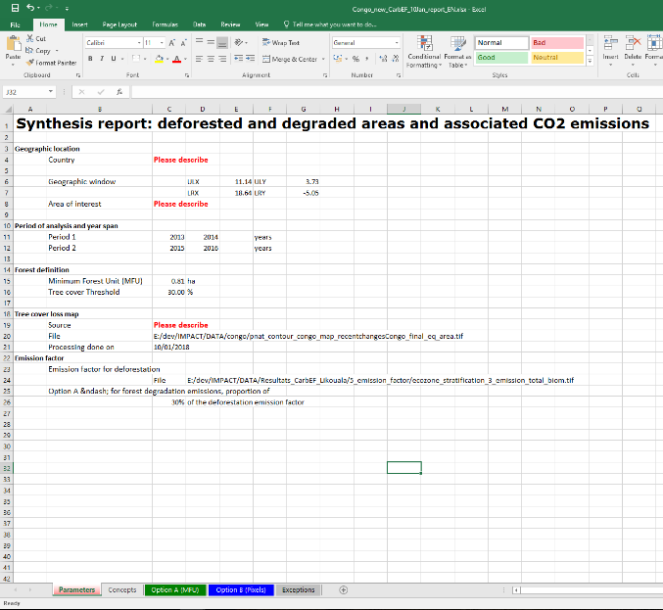
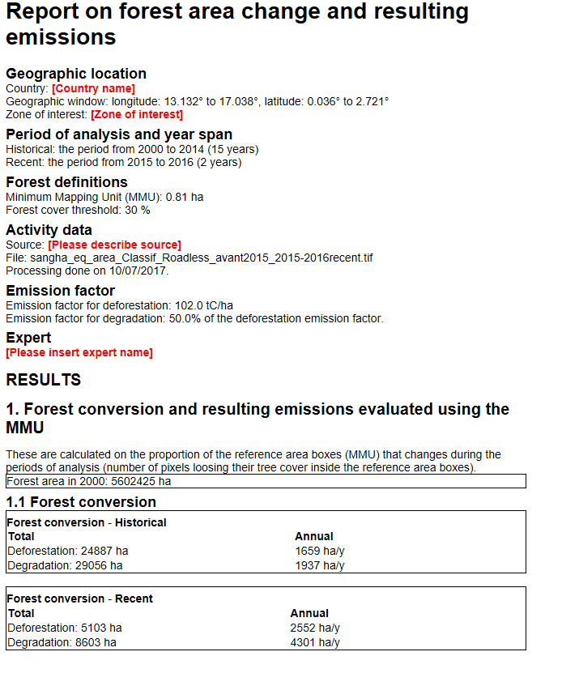
Inputs
Minimum Forest Unit size
Crown cover threshold
or Value
Tree cover loss map
1 band – change over 2 periods
2. Forest definition thresholds
3. Carbon stock
image or constant value
(Optional) Exclusion map
(Optional) land use Shapefile
+ starting and ending years of the 2 periods
+ proportion for forest degradation
CarbEF
Output Filename
Report language
Outputs
Forest change classes map
1 band
Class of the MFU
HTML and Excel reports
Areas of forest changes and associated CO2 emissions

Slide 11
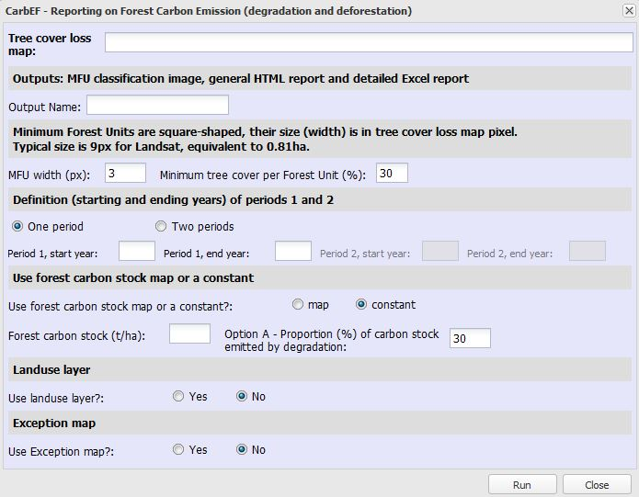
CarbEF in Impact Tool - Inputs
Tree cover loss map
Name
Parameters of the forest definition
Period of work
Map or value of Carbon stock
Landuse shapefile
Map of exceptions

Slide 12
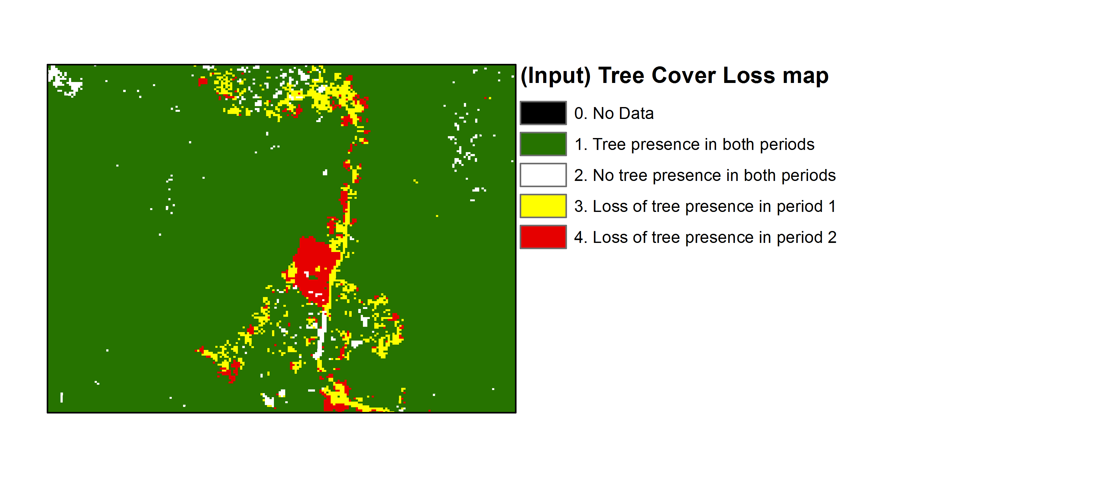
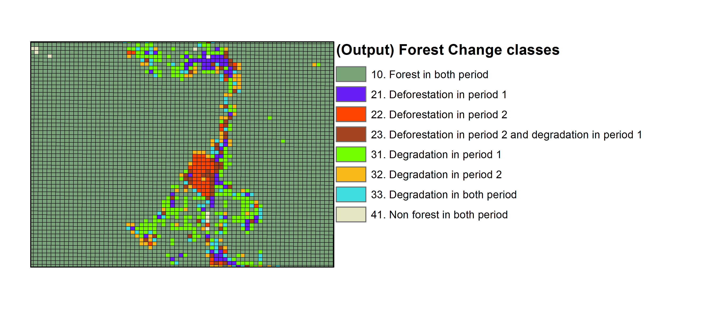
Each forest unit is classified
Example with a tree cover loss map based on Landsat
Input map: pixel width 30 m => area of 0.09 ha
Output map: pixel width 90 m => area of 0.81 h 2 periods

Slide 13
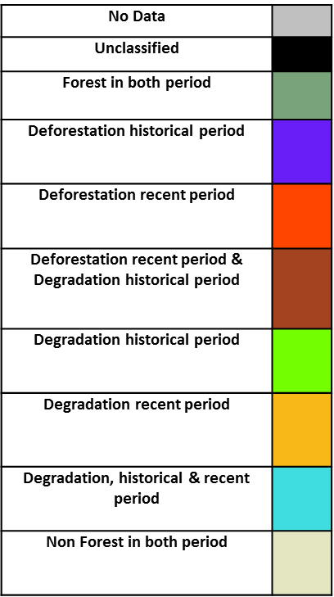
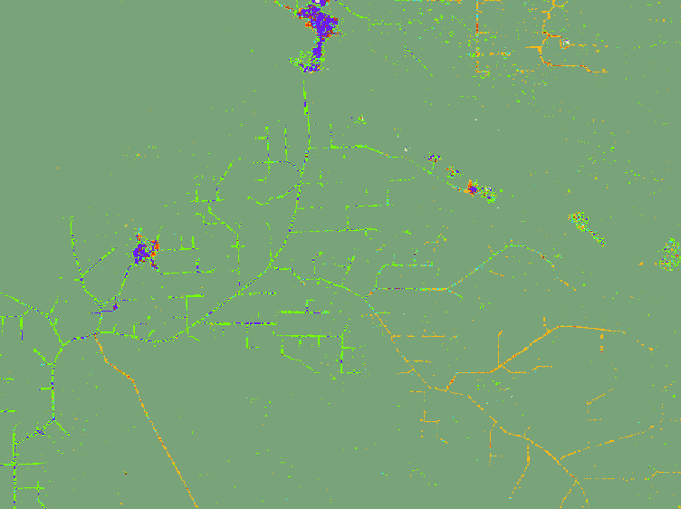
CarbEF in Impact Tool - Outputs
A forest change map at the MFU resolution (here 0.81 ha)

Slide 14
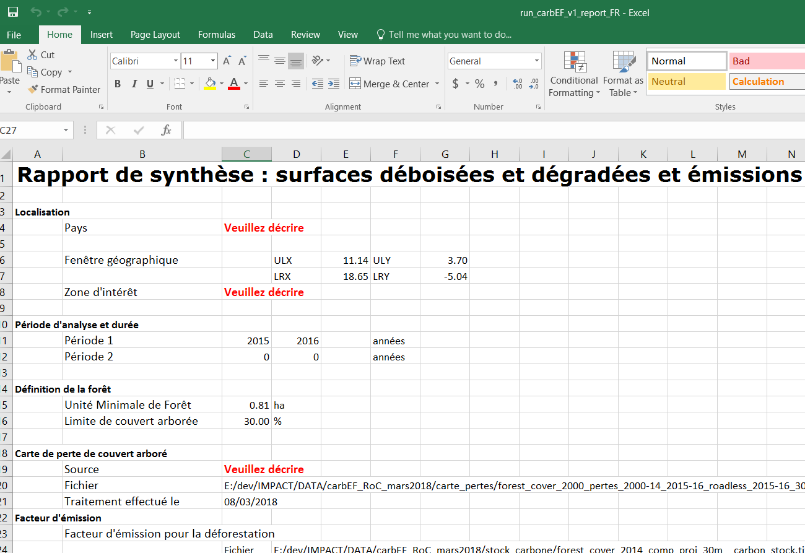
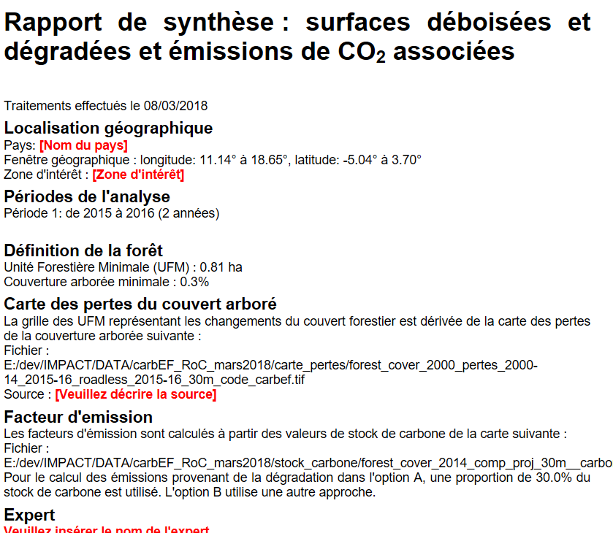
CarbEF in Impact Tool - Outputs
Estimations of the areas of deforestation and forest degradation with associated CO emissions
Html file EN/FR
Excel file EN/FR

Slide 15
Any questions?
You can write to astrid.verhegghen@ec.europa.eu & hugh.eva@ec.europa.eu
You can download Impact software
http://forobs.jrc.ec.europa.eu/products/software/impact.php
You can find documentation on
https://webgate.ec.europa.eu/fpfis/mwikis/impacttoolbox/index.php/Main_Page

